Slide 1
03.02
Linear Regression Assumptions
Level 7 Artificial Intelligence (AI) Data Specialist
Python, Tools and Steps to Build AI Models
Georgina Thomas
g.thomas@learn-tech.com

Slide 2
KSBs
K1: How to use AI and machine learning methodologies such as data-mining, supervised/unsupervised machine learning, natural language processing, machine vision to meet business objectives
K19: The principles and properties behind statistical and machine learning methods
K23: The use of different performance and accuracy metrics for model validation in AI projects
S2: Independently analyse test data, interpret results and evaluate the suitability of proposed solutions, considering current and future business requirements

Slide 3
P17
P17: Pass criterion: Describes how to use statistical, AI and machine learning methodologies such as data- mining, supervised/unsupervised machine learning, natural language processing and machine vision to meet business objectives.
This assessment criterion requires the apprentice to demonstrate their understanding and application of various statistical, AI, and machine learning methodologies to achieve business objectives, examples may include:
Key Methodologies
1. Statistical Methods:
Descriptive Statistics
Inferential Statistics
2. Data Mining:
Purpose: Discover patterns and relationships in large datasets.
Techniques: Clustering, association rule mining, and anomaly detection.
Application.
3. Supervised Machine Learning:
Purpose: Train models on labelled data to make predictions or classifications.
Techniques: Linear regression, logistic regression, decision trees, random forests,
and support vector machines.
Application.
4. Unsupervised Machine Learning:
Purpose: Find hidden patterns or intrinsic structures in unlabelled data.
Techniques: K-means clustering, hierarchical clustering, and principal component
analysis (PCA).
Application
5. Natural Language Processing (NLP):
Purpose: Enable machines to understand and interpret human language.
Techniques: Tokenisation, sentiment analysis, named entity recognition (NER), and
topic modelling.
Application.
6. Machine Vision:
Purpose: Enable machines to interpret and understand visual information.
Techniques: Image classification, object detection, and image segmentation.
Application.
Meeting Business Objectives, such as:
1. Improving Customer Retention
2. Enhancing Customer Experience
3. Optimising Operations
4. Increasing Sales and Marketing Effectiveness
5. Fraud Detection

Slide 4
P19
P19: Pass criterion: Describes the relationship between mathematical principles and core techniques in AI and data science within the organisational context.
Clarification: This assessment criterion requires the apprentice to explain how they use mathematical principles to underpin and explain the core techniques, their use of AI and data science, and how these techniques are relevant to the context of their organisation.
This could include:
Mathematical Principles
Linear Algebra:
Vectors and Matrices: Fundamental for representing data and operations in machine learning algorithms. Used in techniques like Principal Component Analysis (PCA) for dimensionality reduction.
Matrix Decompositions: Techniques such as Singular Value Decomposition (SVD) are used in recommendation systems and image compression.
Calculus:
Differentiation and Integration: Essential for understanding and optimising machine learning models. Gradient descent, a key optimisation algorithm, relies on calculus to minimise the loss function.
Partial Derivatives: Used in back propagation for training neural networks.
Probability and Statistics:
Probability Distributions: Used to model uncertainties and make predictions.
Techniques like Bayesian inference rely on probability theory.
Statistical Methods: Hypothesis testing, confidence intervals, and regression analysis are used to infer patterns and relationships in data.
Optimisation:
Convex Optimisation: Many machine learning algorithms, such as support vector machines (SVMs), rely on convex optimisation techniques to find the best parameters.
Stochastic Optimisation: Methods like stochastic gradient descent (SGD) are used to handle large datasets efficiently.
Core Techniques in AI and Data Science
Supervised Learning:
Regression and Classification: Techniques like linear regression, logistic regression, decision trees, random forests, and support vector machines are used to predict outcomes based on labelled data.
Neural Networks: Deep learning models that use multiple layers to learn complex patterns in data.
Unsupervised Learning:
Clustering: Techniques like K-means and hierarchical clustering are used to group similar data points.
Dimensionality Reduction: Methods like PCA and t-SNE reduce the number of features while preserving important information.
Natural Language Processing (NLP):
Text Analysis: Techniques like tokenisation, sentiment analysis, and named entity recognition (NER) are used to process and analyse textual data.
Language Models: Models like BERT and GPT are used for tasks such as text generation and translation.
Machine Vision:
Image Processing: Techniques like convolutional neural networks (CNNs) are used for image classification, object detection, and segmentation.
Application in Organisational Context
Business Decision-Making:
Predictive Analytics: Using regression models and neural networks to forecast sales, customer behaviour, and market trends.
Risk Management: Applying statistical methods and machine learning to identify and mitigate risks.
Operational Efficiency:
Process Automation: Implementing AI-driven automation for repetitive tasks, such as data entry and customer service.
Quality Control: Using machine vision to detect defects in manufacturing processes.
Customer Insights:
Segmentation and Targeting: Using clustering techniques to segment customers and tailor marketing strategies.
Sentiment Analysis: Applying NLP to analyse customer feedback and improve products and services.
Innovation and Development:
Product Development: Leveraging AI to design and test new products, such as using generative models for design optimisation.
Research and Development: Using data mining and machine learning to discover new insights and drive innovation.

Slide 5
D09
D9: Distinction criterion: Explains when they have challenged the norm through investigating and proposing a solution and the impact this had.
Clarification: This distinction level assessment criterion is asking the apprentice to demonstrate their ability to think critically and innovate by challenging established practices or norms.
Challenging the Norm: Describe a situation where they identified an existing practice, process, or belief that they felt needed improvement or change. This could be in any context, such as a business process, a technical approach, or a team dynamic.
Investigating: Explain how they conducted research or gathered data to understand the issue better. This might involve analysing data, consulting with experts, or reviewing relevant literature. The goal is to show that their challenge was based on informed insights rather than assumptions.
Proposing a Solution: Detail the solution they proposed to address the issue. Highlight the innovative aspects of their solution and how it differed from the existing norm. This could include new methodologies, technologies, or strategies.
Impact: Discuss the impact of their proposed solution. This could involve improvements in efficiency, cost savings, enhanced performance, or other measurable benefits. Be specific about the positive outcomes and how they validated their approach.

Slide 6
Today’s Objectives
Understand :
variance and covariance and correlation
Validate the Linear Regression assumptions:
Multicollinearity(use different methods to reduce it)
Linearity
Mean of Residuals
Homoscedasticity
Normality of Errors

Slide 7
Covariance and Correlation(recap)

Slide 8
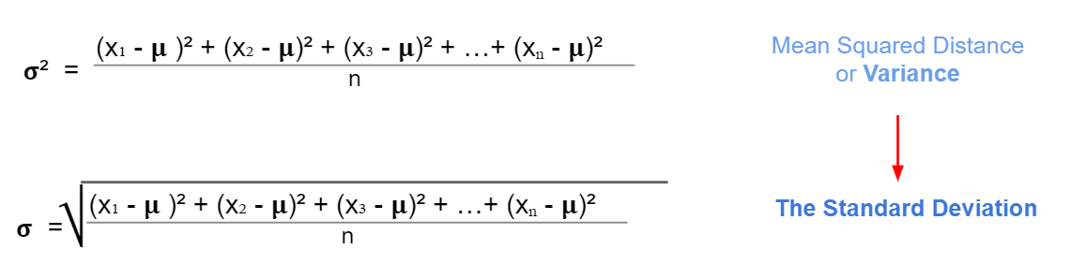
Covariance and Correlation

Slide 9
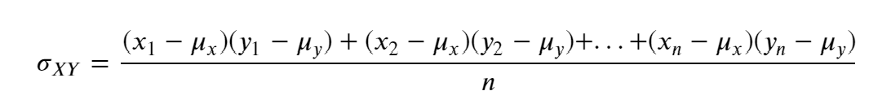
Covariance and Correlation
Covariance is a measure of the joint variability of two variables.
Suppose the greater values of one variable mainly correspond with the greater values of the other variable, and the same is for the lesser values.
In that case, these variables tend to show similar behaviour. Thus, we will say that our covariance is positive.

Slide 10
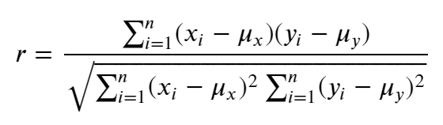
Covariance and Correlation
Covariance ranges between negative and positive infinity, and it only indicates whether two variables are inversely or positively related.
But it isn't easy to know if a relationship between two variables is stronger than the relationship between other pairs of variables.
This is where the concept of correlation comes in.
Correlation is calculated by standardising the covariance by some measure of variability in the data. It produces a quantity that has intuitive interpretations and a consistent unit of measurement.
There are many correlation coefficients, but for now, we will focus on the Pearson correlation.

Slide 11
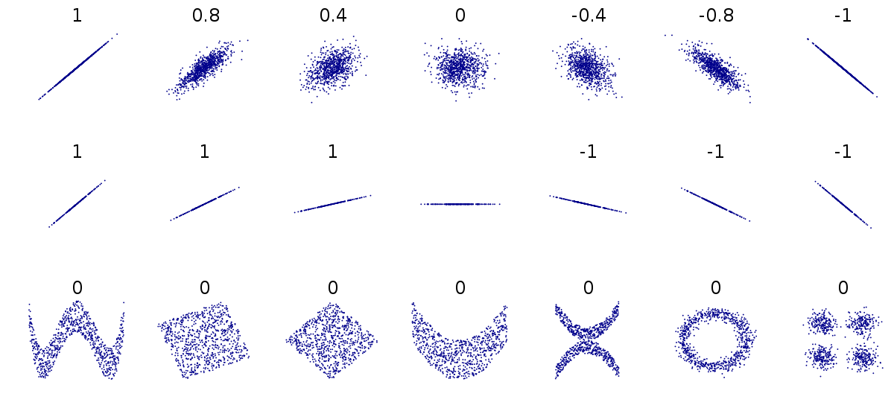
Covariance and Correlation
Linear and non-linear relationships

Slide 12
Covariance and Correlation
Correlation is not causation
Causation occurs when a change in the value of one variable leads to a change in the value of another variable, indicating that one variable causes the change in the other. In other words, they have a cause-and-effect relationship.
Check this website for some insane correlations: https://www.tylervigen.com/spurious-correlations
Therefore, we cannot draw a conclusion based solely on correlation. This should be just the first step. We should take the time to identify other underlying factors, verify their accuracy, and then draw a conclusion.

Slide 13
Linear Regression Assumptions

Slide 14
Assumptions
Linearity – the relationship between X and the mean of Y is linear.
Mean of Residuals - The mean of residuals should be zero.
Homoscedasticity - Homoscedasticity means that the residuals have equal or almost equal variance across the regression line.
Normality of errors – the errors should be normally distributed.
Independence – no perfect correlation. The predictors are independent of each others.

Slide 15
The problem of multicoliniarity

Slide 16
The problem of multicollinearity
Multicollinearity occurs when independent variables in a regression model are highly correlated with each other. Due to this, a change in one variable would cause a change in another, resulting in significant fluctuations in the model results.
Therefore, the model results will be unstable and vary significantly, even with a slight change in the data or model.
We cannot rely on the estimated coefficients
The unstable nature of the model can cause over-fitting
Therefore, when selecting features for our model, we must ensure that there is no multicollinearity.

Slide 17
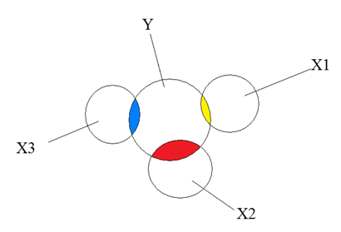
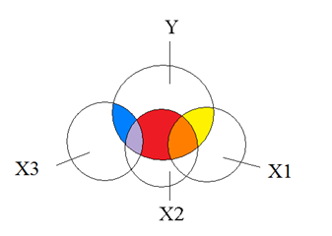
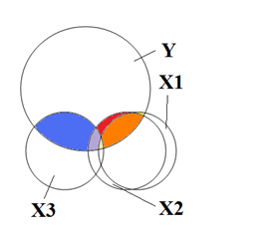
Multicollinearity explained with diagrams https://www.theanalysisfactor.com/multicollinearity-explained-visually/
No multicollinearity at all
Moderate multicollinearity
Extreme multicollinearity

Slide 18
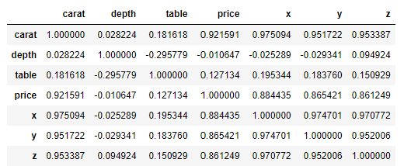
The problem of multicollinearity

Slide 19
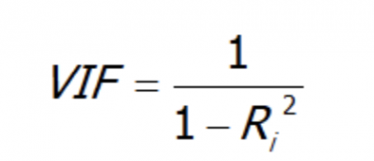
Variance Inflation Factor
VIF is a number that determines whether a variable has multicollinearity or not. That number also represents the extent to which a variable is inflated due to its linear dependence on other variables.
It is calculated by regressing a variable against every other variable.
Assuming you have a list of features — x₁, x₂, x₃, and x₄. You first take the first feature, x₁, and regress it against the other features:
x₁ ~ x₂ + x₃ + x₄
And you find the R-squared for x1 being the target. If R-squared is large --> x1 is highly correlated with the three features - x2, x3, x4. If R-squared is small --> x1 is not correlated with the free features - x2, x3, x4.
Source: https://towardsdatascience.com/statistics-in-python-collinearity-and-multicollinearity-4cc4dcd82b3f

Slide 20
The problem of multicollinearity
A value of 1 indicates there is no correlation between a given explanatory variable and any other explanatory variables in the model.
A value between 1 and 5 indicates moderate correlation between a given explanatory variable and other explanatory variables in the model, but this is often not severe enough to require attention.
A value greater than 5 indicates potentially severe correlation between a given explanatory variable and other explanatory variables in the model. In this case, the coefficient estimates and p-values in the regression output are likely unreliable.
source: https://www.statology.org/how-to-calculate-vif-in-python/

Slide 21
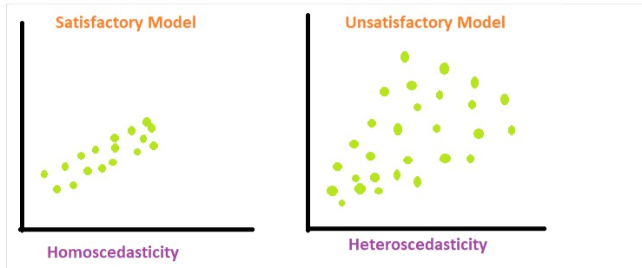
Homoscedasticity
Homoscedasticity means that the residuals have equal or almost equal variance across the regression line. By plotting the error terms with estimated terms we can check that there should not be any pattern in the error terms.
https://www.geeksforgeeks.org/machine-learning/heteroscedasticity-in-regression-analysis/

Slide 22
Recap, OTJ, next week

Slide 23
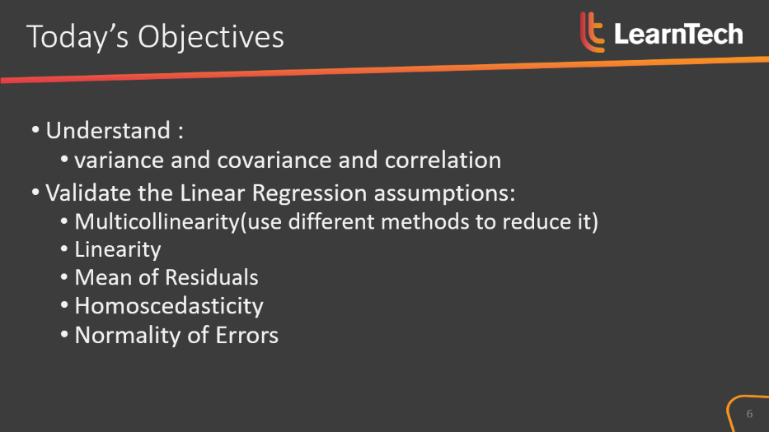

Recap of today’s objectives

Slide 24
OTJ Activities
Predict the house prices
Use the Seattle houses data to build a regression model. The model has to be able to predict the prices of the new houses. Check all requirements from the given Jupyter Notebook.
2. Read through the Regularisations slide deck and complete the notebook.

Slide 25
Next week…
Other Regression models
How to improve the model:
Feature Engineering,
Augmentation
Scaling

Slide 26
See you next week!
😊

